Slide 1
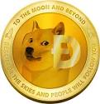
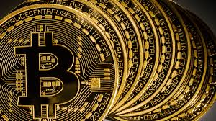
The Road runners of wall street
Mike Mahoney and Surendra Thapa

Slide 2
Background
What is it?
Cryptography Currency
It is a decentralized (for now) currency designed to operate outside of central banks
There is a finite supply
Many use the block chain system
Mined by performing transactions
Like verifying transactions in a master ledger
HIGHLY UNSTABLE

Slide 3
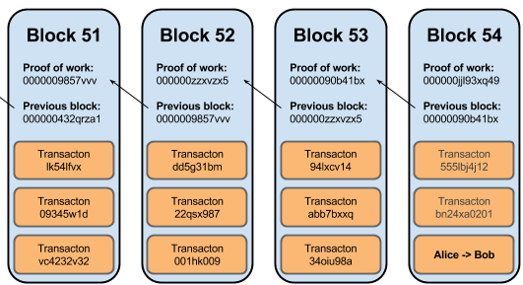
How is Bitcoin Mined?
Each encryption has three main components:
Public Key
Secret Key
SHA-256 : The hash function
Every user has access to the master ledger with all transactions ever
A block is verified and 1 “miner” is rewarded with bitcoin
3.125 is current reward
21 million total bitcoin
M -> S

Slide 4
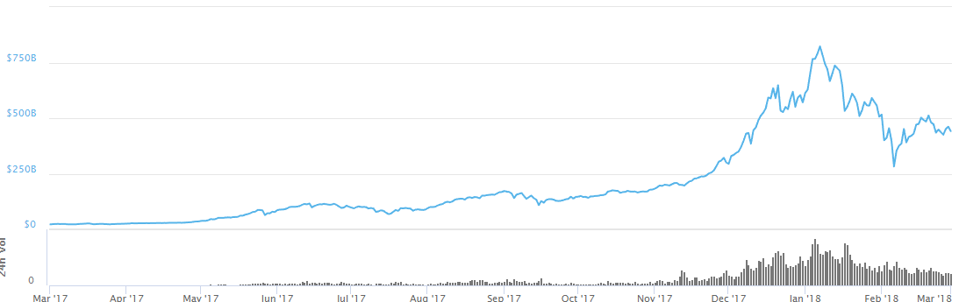
Motivation
Market Capitalization of all Cryptocurrencies $441 Billion (of 03/01/18 0100)
A 15% increase from 02/21/18

Slide 5
Data Set/Sources
Originally from Kaggle, but its not a primary source!
Web scrape of https://coinmarketcap.com from 01/01/17 to 02/23/18 (except Bitcoin – 04/28/13)
Features:
Symbol
Date
Rank
Open
Close
High
Low
Spread
OHLC

Slide 6

Can We Predict It???
General Autoregressive Conditional Heteroskedastic
GARCH Model
Used when high variance and volatility is present
Modified form of ARIMA
Predicting 5 days out using 6-10 days prior depending on the currency

Slide 7
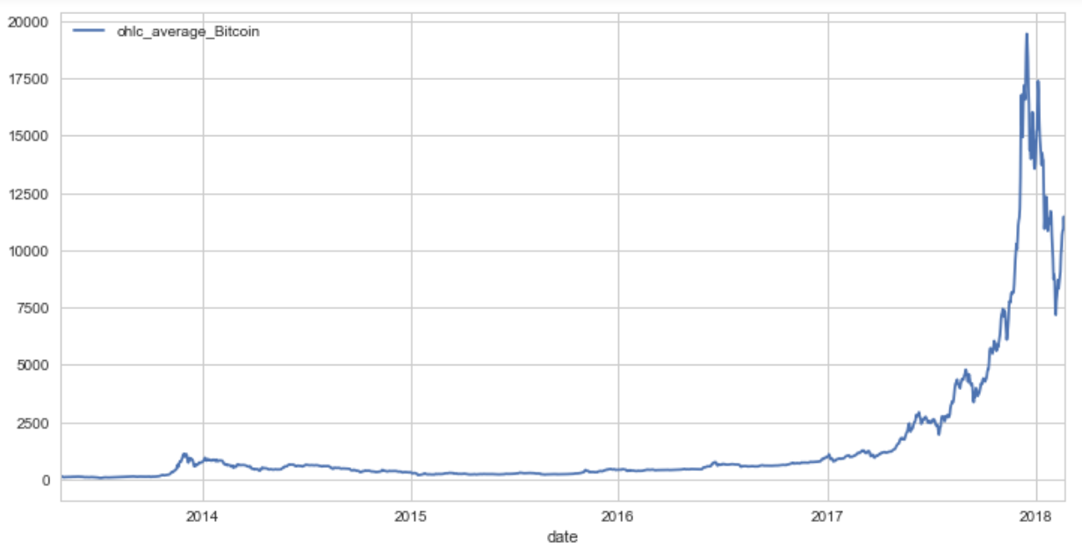
Plotting Bitcoin

Slide 8
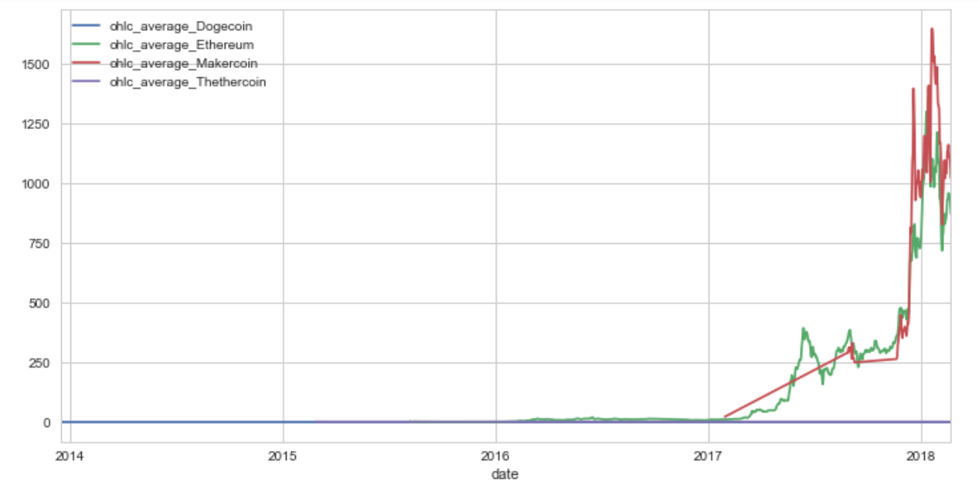
Plotting the Others

Slide 9
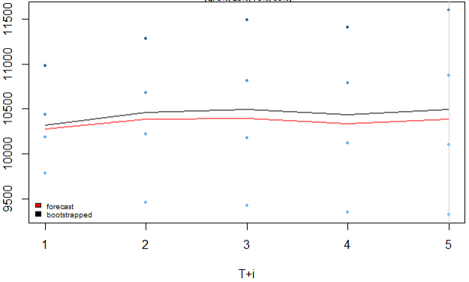
Predicting Bitcoin
Predicting Bitcoin
02/24-02/28
Bitcoin Close 02/28:
10397.90 USD

Slide 10
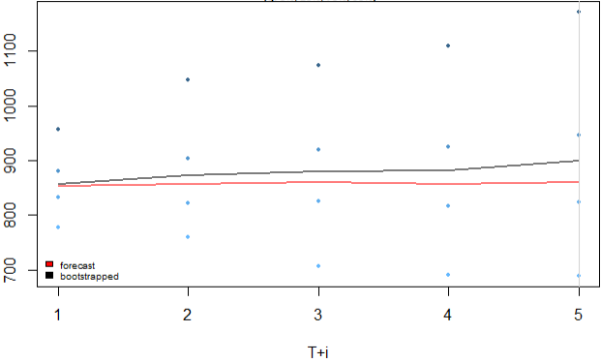
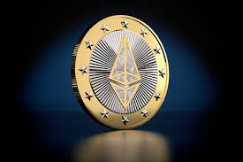
Predicting Ethereum
Predicting Ethereum
02/24-02/28
Ethereum Close 02/28:
855.20 USD

Slide 11
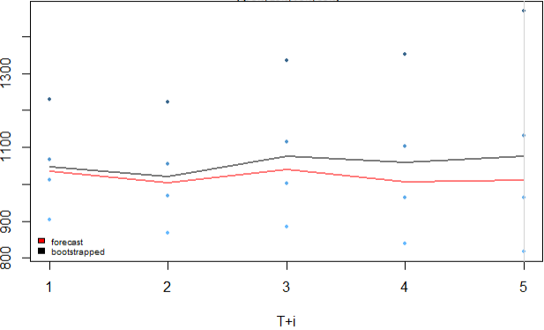

Predicting Maker
Predicting Maker
02/24-02/28
Maker Close 02/28:
1028.82 USD

Slide 12
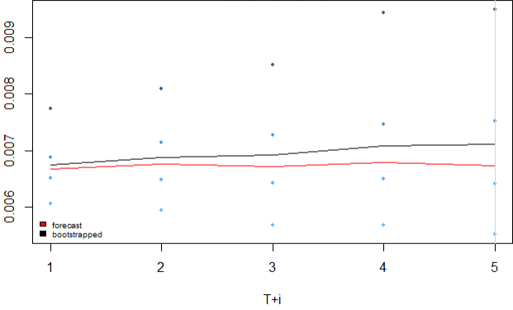
Predicting Dogecoin
Predicting Maker
02/24-02/28
Maker Close 02/28:
0.006018 USD

Slide 13
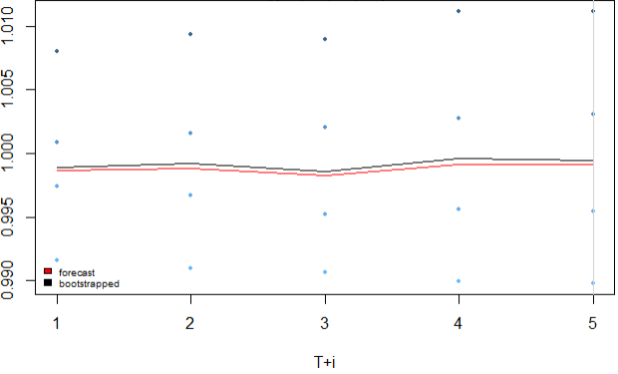

Predicting Tether
Predicting Maker
02/24-02/28
Maker Close 02/28:
0.998903 USD

Slide 14
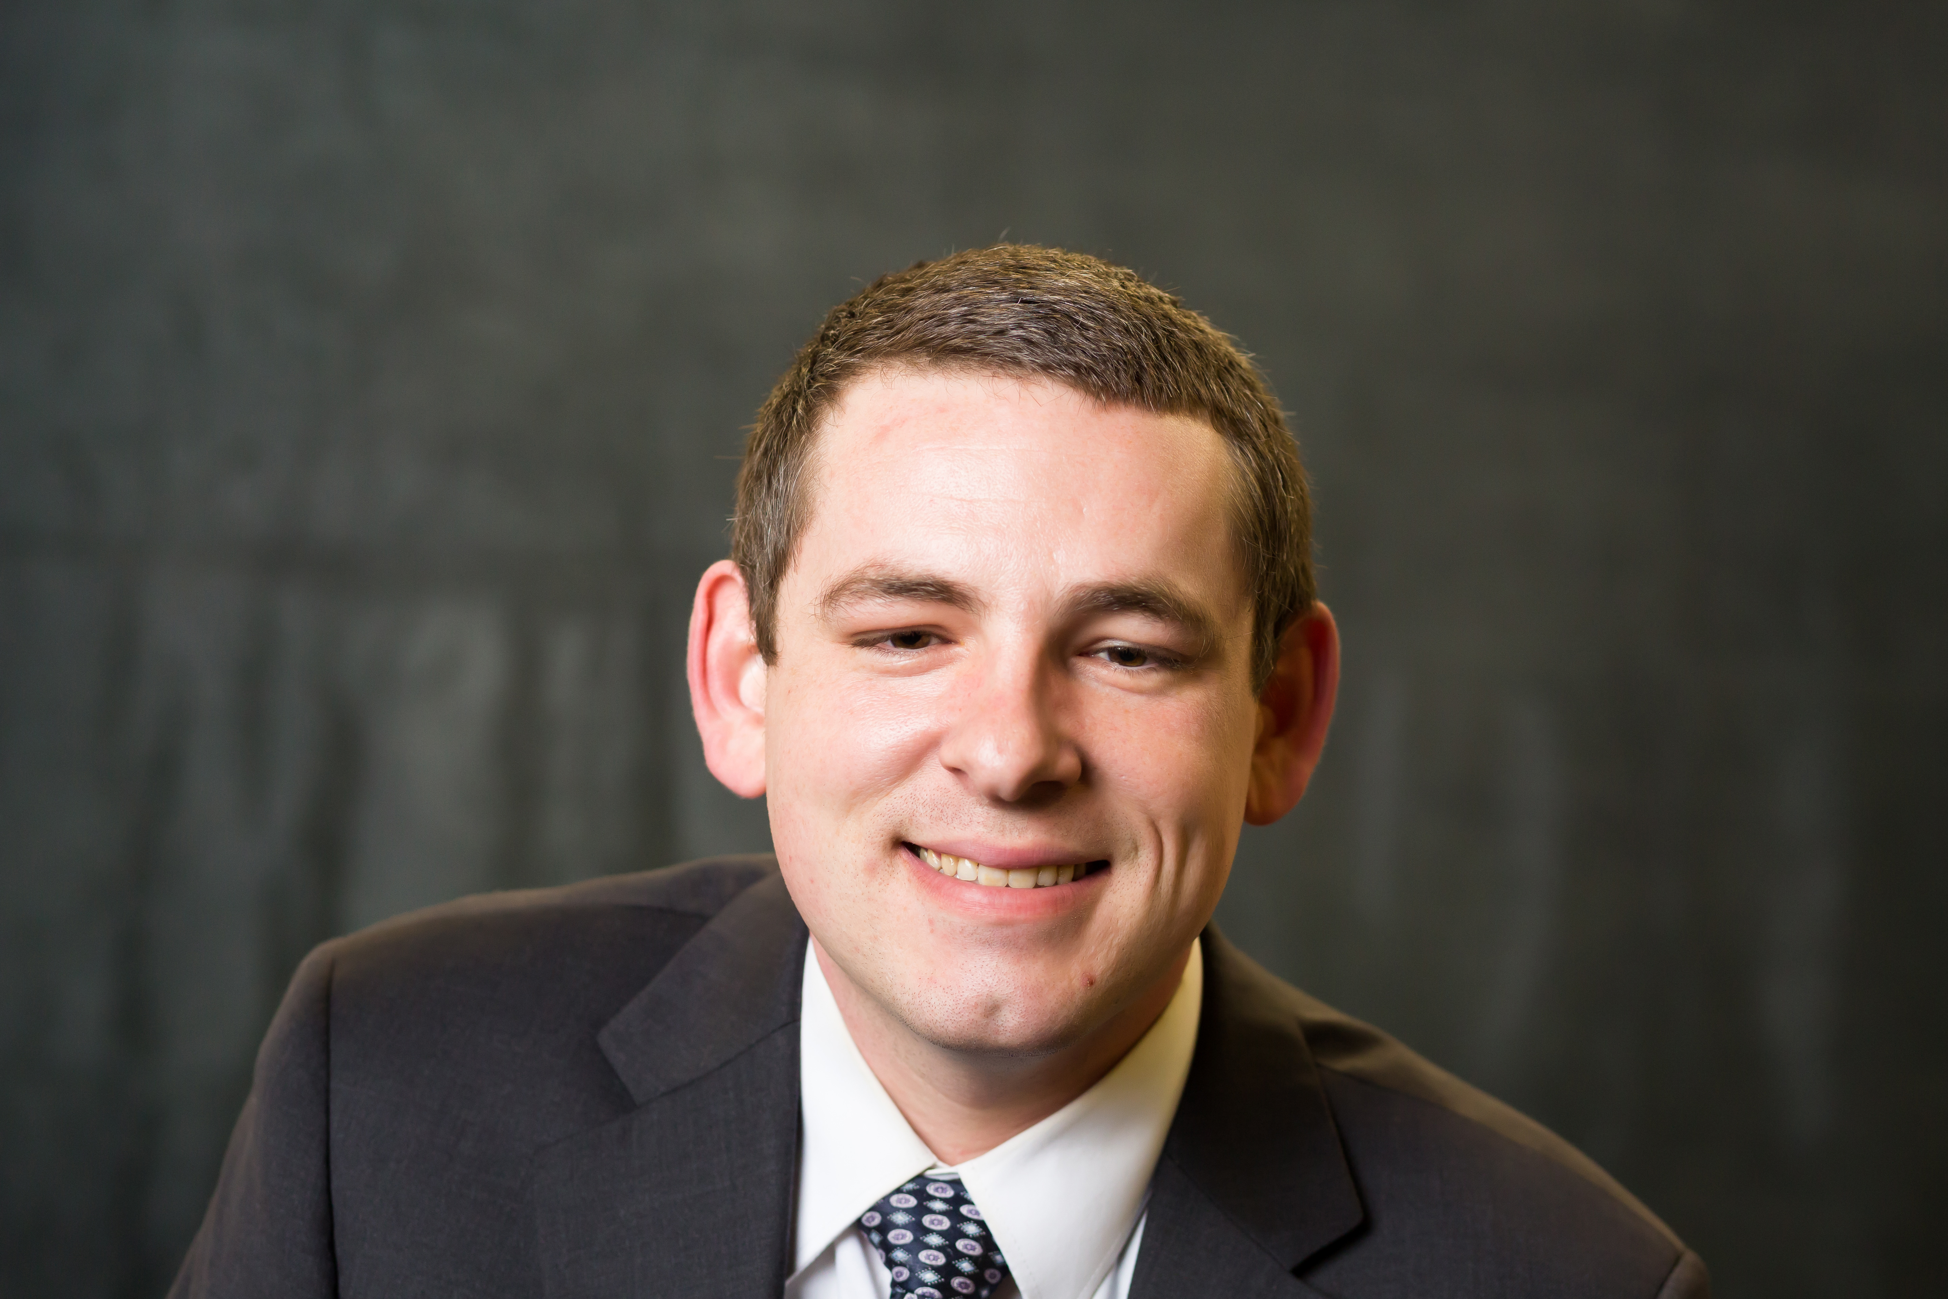
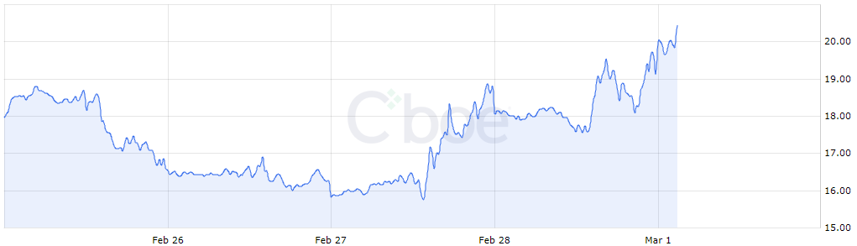
Advice from Uncle Mike
Two factors are going to greatly impact the Crypto Market:
1: Options
2: Regulation

Slide 15
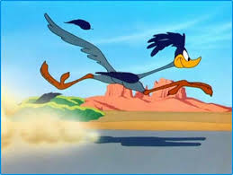
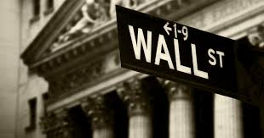
Disclaimer
Please use extreme caution when trading any and all cryptocurrencies. These “assets” are extremely volatile and highly unpredictable. Furthermore, if you decide to trade in these “assets” you are doing so at you own risk, the Roadrunners of Wall Street, LLC. are not responsible for any losses incurred! However, if extreme gains are incurred we will gladly take donations below $14K and Dogecoin!
The
Of
LLC

Slide 16
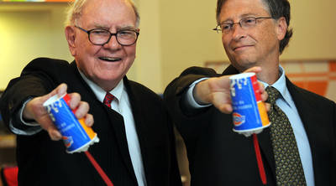
Advice from Grandpa Warren
“They should try to be fearful when others are greedy and greedy only when others are fearful”
Warren Buffet and Bill Gates

Slide 17

?????????????????????????????????????????????????????????????????????????????????????????????????????????????
?????????????????????????????????????????????????????????????????????????????????????????????????????????????
?????????????????????????????????????????????????????????????????????????????????????????????????????????????
?????????????????????????????????????????????????????????????????????????????????????????????????????????????
?????????????????????????????????????????????????????????????????????????????????????????????????????????????
?????????????????????????????????????????????????????????????????????????????????????????????????????????????
?????????????????????????????????????????????????????????????????????????????????????????????????????????????
?????????????????????????????????????????????????????????????????????????????????????????????????????????????
?????????????????????????????????????????????????????????????????????????????????????????????????????????????
?????????????????????????????????????????????????????????????????????????????????????????????????????????????
?????????????????????????????????????????????????????????????????????????????????????????????????????????????
?????????????????????????????????????????????????????????????????????????????????????????????????????????????
?????????????????????????????????????????????????????????????????????????????????????????????????????????????
?????????????????????????????????????????????????????????????????????????????????????????????????????????????
?????????????????????????????????????????????????????????????????????????????????????????????????????????????
?????????????????????????????????????????????????????????????????????????????????????????????????????????????
?????????????????????????????????????????????????????????????????????????????????????????????????????????????
?????????????????????????????????????????????????????????????????????????????????????????????????????????????
?????????????????????????????????????????????????????????????????????????????????????????????????????????????

Slide 18
References
https://coinmarketcap.com/charts/
https://www.coindesk.com/information/how-bitcoin-mining-works/
https://99bitcoins.com/price-chart-history/
https://blockgeeks.com/guides/what-is-cryptocurrency/

